Slide 1





Health & Physical Education
Curriculum Design

Slide 2

Health & Physical Education Curriculum Intent
The Physical Education curriculum will develop the physical, mental and social health of our young people using sport and exercise as the vehicle to achieve this.
Pupils will develop their motor competence in a range of sports and activities and learn how to apply these in cooperative and competitive situations. The Academy values of: Integrity, Care and Excellence will be embedded throughout the curriculum but particularly in competitive situations to encourage sportsmanship, the ability to win well and cope with setbacks.
Pupils will develop their understanding of health and sport science applying this to a range of wider world contexts.

Slide 3
Key Stage 3
To meet the intent of the curriculum, lessons will be taught through sustained periods of physical activity in a range of sports / activities.
The kit requirements, assessment method and curriculum block information can be found on the following pages.
Pupils can continue to develop their physical skills in a range of extra-curricular clubs and potentially represent the Academy in competitive fixtures.
The PE department run various sporting trips and visits throughout the year to inspire pupils and provide them with valuable life experiences.
Further information about all the above is found on our Firefly page here:
https://chellaston.fireflycloud.net/physical-education

Slide 4
Year 7 Curriculum
Introduction to HPE – Intent and expectations
Green – Benefits of exercise on health
Yellow – Physical Education blocks focused on motor competence
Orange – Opportunities for personal development through exercise & sport
Health: Long term benefits of exercise through circuits
Net & Wall Games:
Maintain and win a rally through Pickleball
Creative: Body control & movements in Gymnastics & Dance
Invasion games: Basic skills and tactics to outwit opponents in Football
Strike & Field: Bowling, batting and fielding with accuracy
Athletics: run, jump, throw and officiate
Sporting values: Understanding of skills, tactics & values through Netball or Rugby
Competition/PD:
Understanding healthy competition in sport
Teamwork, fitness and movement skills
Health: Long term benefits of exercise through running

Slide 5
Year 8 & 9 Curriculum
Over the two years, all pupils will work through and aspire to complete the following blocks
Net & Wall Games:
Skills & tactics in Pickleball & Badminton
Invasion games: adapt invasion skills & tactics through Basketball.
Creative:
Body control, movements & sequences in Gymnastics & Dance
Invasion games:
Skills, strategies & tactics to outwit opponents in Football
Invasion games: Adapt invasion skills & tactics through Australian Rules or Rugby.
Athletics:
Run, jump, throw & officiate
Strike & Field: Bowling, batting & fielding with accuracy
Sporting values: Understanding of skills, tactics & values through Netball or Rugby
OAA/PD:
Teamwork, fitness & movement skills
Leadership/PD:
Effective personal behaviours, planning and communicating through leadership
Competition/PD:
Understanding being part of a team and experiencing healthy competition in sport
Health:
Understand the importance of & techniques for resistance training
Health:
Long term benefits of exercise through running
Health:
Benefits of exercise through fitness classes
Health:
Understand how to plan & implement a personal training programme

Slide 6
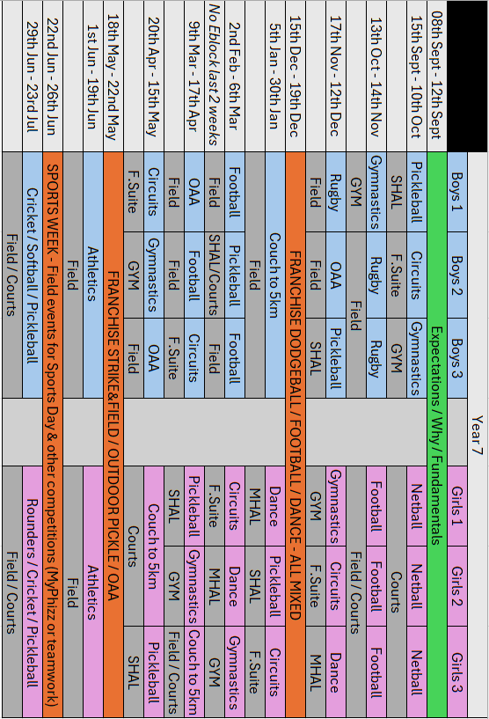

Slide 7
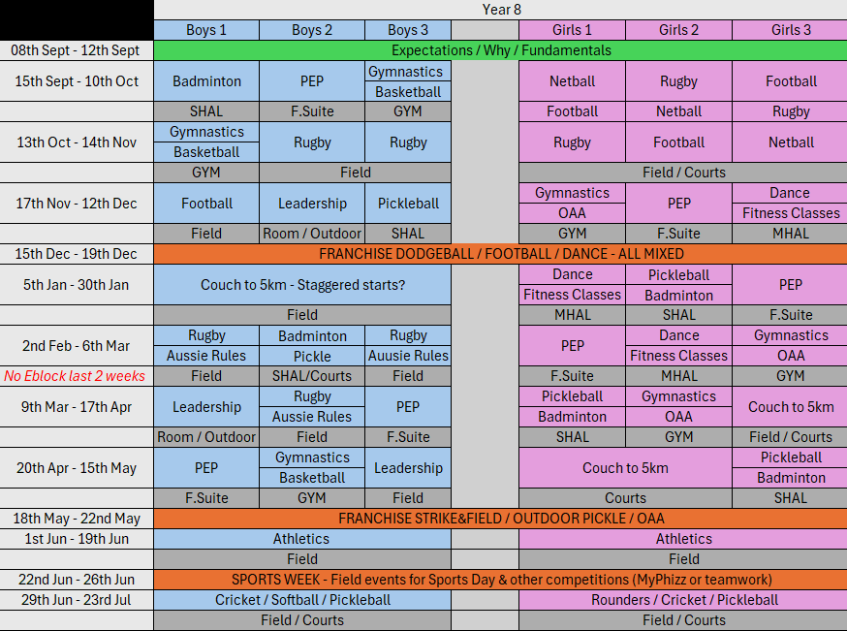

Slide 8
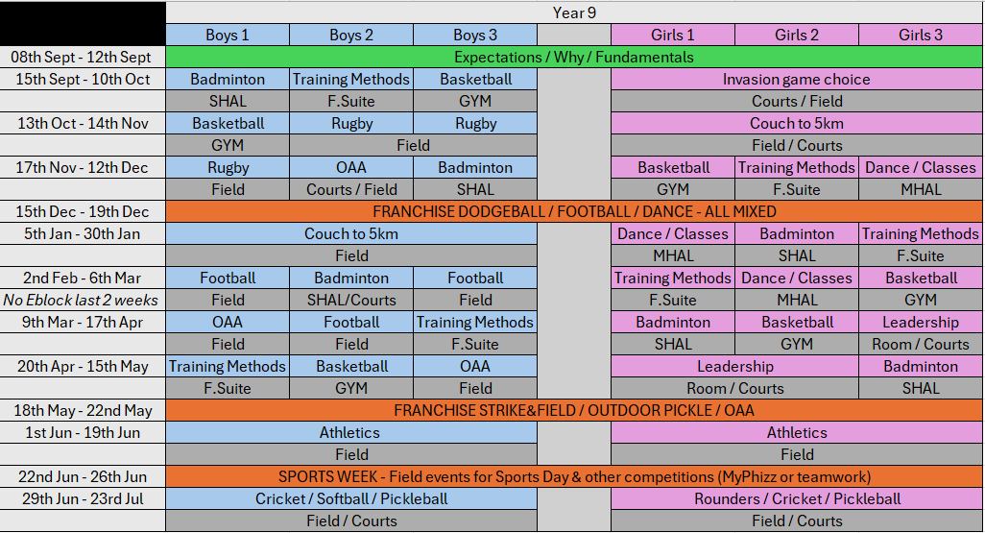

Slide 9
HPE & PSHCE at Chellaston Academy
HPE Introduction lesson to cover:
Benefits of exercise and our expectations of intensity
H20 – strategies for maintaining personal hygiene
Through the health-related exercise blocks, pupils will learn:
H1 – recognise and demonstrate personal strengths, build self-confidence, self esteem and good health and wellbeing.
H4 – strategies to help build resilience to negative opinions, judgements and comments.
H10 – Promote wellbeing and boost mood using physical activity, participation and the value of positive relationships.
H14 – the benefits of physical activity and exercise for physical and mental health and wellbeing.
H16
L2 – to review their strengths, interests, skills, qualities and values and how to develop them.
L3 – to set realistic yet ambitious targets and goals.
Through the personal development blocks, pupils will learn:
H9 – strategies to understand and build resilience, as well as how to respond to disappointments and setbacks
L4 – the skills and attributes that employers value

Slide 10
Kit Requirements
I am mindful of the cost and accessibility of items when designing the PE kit expectations. Uniformality stocks our Chellaston Academy branded items and you can find the link to their page below. A branded top (long sleeve OR polo) is the only item you must have from them. The rest of the items may be found cheaper elsewhere but they must be ‘plain black’. Brands often put one small logo somewhere on the garment which is fine. The table below should be clear but if you have any questions please email: T.Howard@chellaston.derby.sch.uk
If your child is excused from practical involvement, please write us a formal note and ensure your child still has their kit. We will decide if they change into all or some of the kit depending on: the reason for being excused, the weather, the facility we are using and their non-practical involvement that lesson.
All jewellery must be taped or removed quickly in the changing room, long hair must be tied back, and all religious headwear tucked in to reduce the risk of injury.
Indoor / Courts / Field (Summer) | Field (Winter)
Sports trainers (not what they wear to school) | Studded boots (any form)
Sport socks (trainer, invisible, sport) | Black long football socks
Plain black sport shorts / skort / cycling short
Chellaston Academy branded t-shirt / top
Long hair tied up
Jewellery removed
Optional - Plain black sports leggings
Optional - Plain black sports tracksuit bottoms
Optional – Plain black base layer garments worn under PE kit
https://www.uniformality.co.uk/chellaston-academy-207-c.asp

Slide 11




Assessment in PE
Head – Literacy focus
Heart – Attitude to learning
Hands – Physical skills
Pupils will be given one of the 4 statements below for each of the 3 strands of assessment:
Rarely demonstrates…
Sometimes demonstrates…
Mostly demonstrates…
Always demonstrates…
Head
…the knowledge and understanding of the literacy focus
Heart
…the Academy values of Integrity, Care and Excellence with the expected level of effort in PE
Hands
…the specific physical skills that are associated with the sport or activity in the curriculum

Slide 12
KS3 Literacy Focus
Health
Health:
A state of complete mental, physical and social well-being; not merely the absence of illness.
Fitness:
Your physical ability to meet the demands of your environment.
Long term benefits:
Positive adaptations made to the body as a result of REGULAR physical activity
Physical benefits of exercise:
Regular participation in exercise will improve physical health and reduce the risk of the following:
Obesity
Coronary Heart Disease
High blood pressure
Osteoporosis
Type 2 diabetes
Mental benefits of exercise:
Regular participation in exercise will improve your mental health and help with:
Self-esteem / confidence
Stress management
Reducing anxiety
Cognitive function
Social benefits of exercise:
Regular participation in exercise or sport can improve your social health by:
Being part of a team / group
Cooperating with other people
Communicating
Developing friendships
Reducing the feeling of loneliness

Slide 13
KS3 Literacy Focus
Sporting Values
Pupils will learn the following sporting values through their practical Rugby, Netball or Football PE lessons
Sportsmanship
Behaviour that demonstrates positive sporting values such as fair play, respect and gracious behaviour whether winning or losing.
Respect
Respect is treating someone in a way that shows regard for their feelings, wishes, decisions and traditions. This means that you accept somebody for who they are, even when they’re different from you or you don’t agree with them.
Fair Play
Fair play in PE and sport is whereby all players and participants follow the set rules with honestly. You should play to win fairly. A good attitude towards teammates, opposition and officials is also encouraged.
Determination
A quality that makes you continue trying to do or achieve something that is difficult. Being determined is the will to prepare and play to achieve a positive result even when faced with challenges or defeat.
Discipline
The practice of encouraging people to obey rules or a code of behaviour. PE can help develop your self-control and behave appropriately in an activity or in the community.

Slide 14
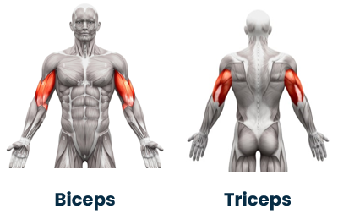
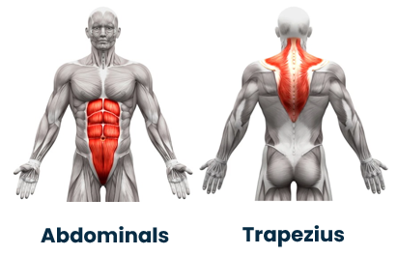
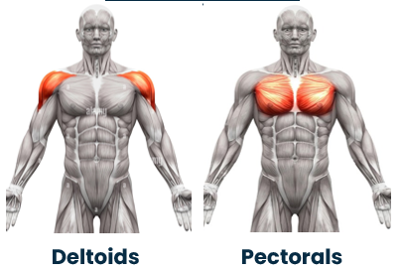
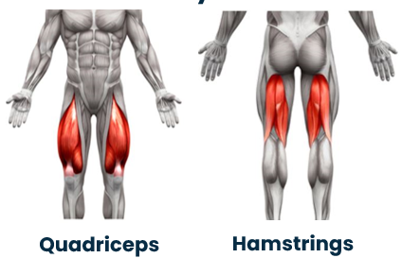
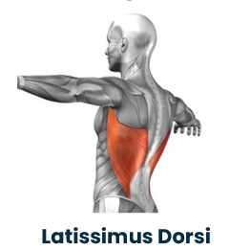
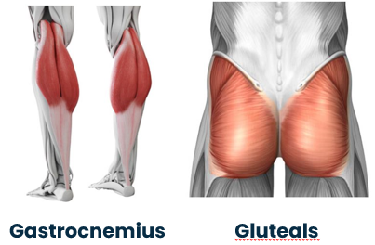
KS3 Literacy Focus
Muscles
Pupils will learn the following muscles through their Net/Wall PE lessons
Activities:
1. Point to the muscle(s) on your body
2. Do an exercise that uses the muscle(s)
3. Spell the muscle(s)

Slide 15
KS3 Literacy Focus
Fitness
Pupils will learn the following components of fitness through their Athletics and Strike/Field PE lessons
Muscular Endurance
The ability of a muscle or muscle group to repeatedly contract or keep going without tiring
Fitness test
Press-up or Sit-up test
Cardiovascular Endurance:
The ability to continuously exercise the whole body without tiring.
Fitness test:
12 Minute Cooper Run.
Speed:
The ability to move the body or body parts quickly
Fitness test:
30m sprint
Power
Strength x speed (maximal force performed at speed)
Fitness test
Vertical jump or Broad jump test
Reaction Time:
The time taken to respond to a stimulus.
Fitness test
Ruler Drop Test
Coordination
The ability to use two or more body parts together
Fitness test
Wall throw test
Agility:
The ability to change direction at speed
Fitness test
Illinois Agility Test
Flexibility:
The range of movement available at a joint
Fitness test
Sit and reach test
Strength
The maximum force a muscle or group of muscles can apply against a resistance
Fitness test
Grip strength dynamometer
1 repetition maximum (1RM)
Balance
The ability to keep your centre of mass over a support base. Maintaining equilibrium whether stationary or moving
Fitness test
Stork stand test

Slide 16






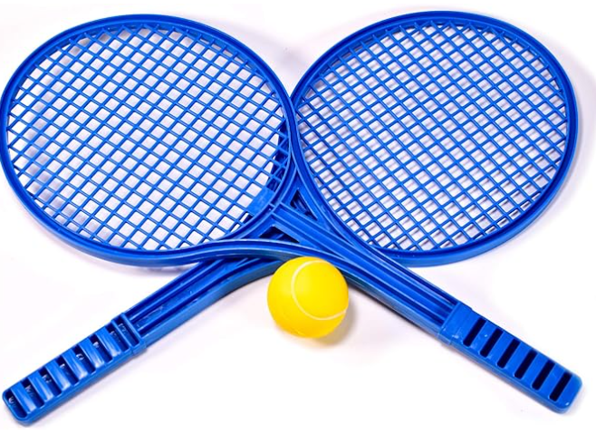





Key Stage 3 Activity Blocks
Invasion Games
Passing & Receiving
Movement
Attacking
Defending
Net/Wall Games
Movement & Positioning
Serve
Attacking
Defending
Strike/Field Games
Throwing
Catching
Batting
Bowling
Creative
Timing & Phrasing
Balance & Control
Performance skills
Choreography skills
Physical Attributes
Fitness for all of the above and Fitness block to include
Reps / sets
Heart rate – resting, working and recovery
Circuit training
Continuous / cardiovascular
Resistance (weight) training / muscular endurance and strength
Personal exercise programme / specificity

Slide 17




Sport / activity specific skills
Football
Netball
Basketball
Ball control
Passing
Shooting
Dribbling
Tackling
Passing
Footwork
Dodging & marking
Positions
Shooting & rebounds
Passing
Shooting & rebounds
Dribbling
Marking
Rugby
Badminton
Pickleball
Ready position &
movement
Serving
Overhead clear & smash
Drop shot & net lift
Drive
Beating opponents
Passing & receiving
Tackling & landing
Rucking
Kicking
Ball Familiarisation
Serve
Movement
Rally
Competition
OAA
Gymnastics
Dance
Travel
Flight & landing
Balance
Roll
Rotation
Transitions
Teamwork
Problem solving
Orienteering
Rhythm, counts & beats
Individual skills
Choreographic devices
quality of movement
Cricket
Rounders /
Softball
Athletics
Batting
Bowling
Throwing
Catching
Batting
Bowling
Throwing
Catching
Sprinting
Relay
Pacing
Jumping
Throwing

Slide 18
Lesson Structure - MATE
Lesson time
Mental concept
Activate / Activity
Embed
Teachable moments
Head assessment criteria
Introduce the ‘Literacy focus’. Ask pupils to consider the questions during the warm-up.
.
Activate/Activity – Hands assessment criteria
Provide opportunity for pupils to link the literacy focus with the physical activity. Sustained periods of physical activity enabling students to practice the skill/movement. Majority of the lesson
Teachable moments
Times when teaching can enable progression. For example: WAGOLL, reinforcement,
feedback (individual or group), responsive teaching / addressing misconceptions.
Embed
Revisit the concept / ‘word of the week’ and make connections to the lesson, school life or wider world.

Slide 19
Sequencing
Where appropriate the blocks will follow the sequencing pattern below.
Lesson 1
Lesson 5
Lesson 2
Lesson 6
Lesson 6
Lesson 3
Lesson 7
Lesson 4
Lesson 8
.
First delivery of skills
Revisit & Consolidate
Summative assessment
Introduce the skill and allow deliberate practice of the skill in isolation and competitive situations.
Deliver lessons as per the lesson structure.
Revisit skills and techniques addressing misconceptions or allowing deliberate practice.
Allow pupils to demonstrate progress through engagement in competitive activities.

Slide 20
Key Stage 4 Curriculum (Core)
Pupils that study examination PE will be guided through the practical assessment for their course and awarded grades that directly contribute to their GCSE results.
Pupils that are not studying examination PE will rotate between blocks of work with the primary focus being movement and encouraging lifelong participation. Due to their key stage, helpful skills for their chosen careers will be delivered through leadership and blocks of healthy competition.

Slide 21
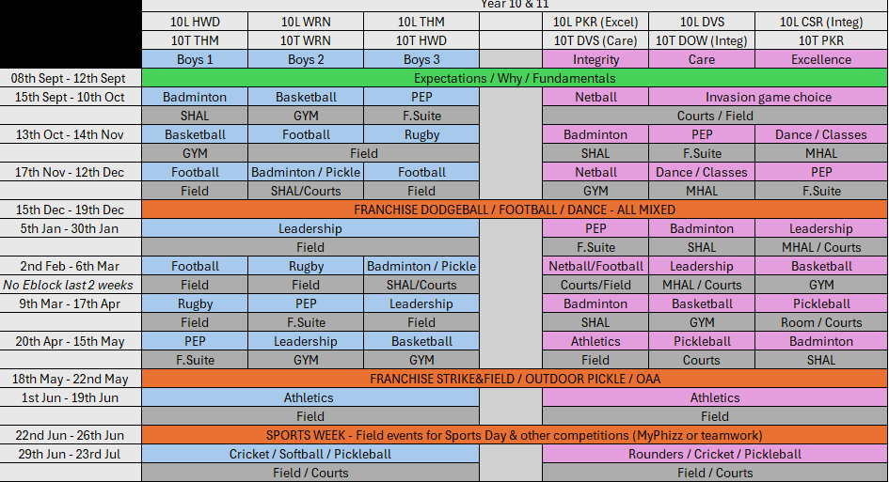

Slide 22


Key Stage 4 Examination PE
Pupils will be guided down a pathway that suits them and maximises their potential in Physical Education
4
OCR GCSE
Physical Education
30% Practical assessment
10% Coursework
60% Exam (year 11)
https://www.ocr.org.uk/qualifications/gcse/physical-education-j587-from-2016/
OCR website link & Firefly resources
https://chellaston.fireflycloud.net/physical-education/ks4/gcse-physical-education

Slide 23
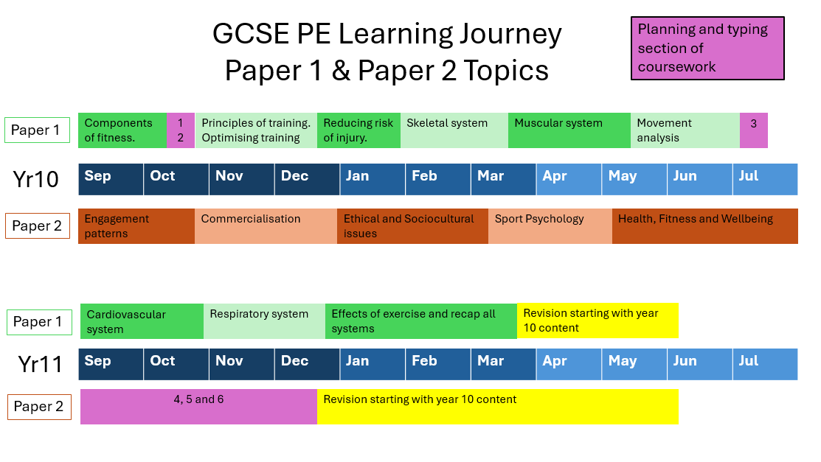

Slide 24
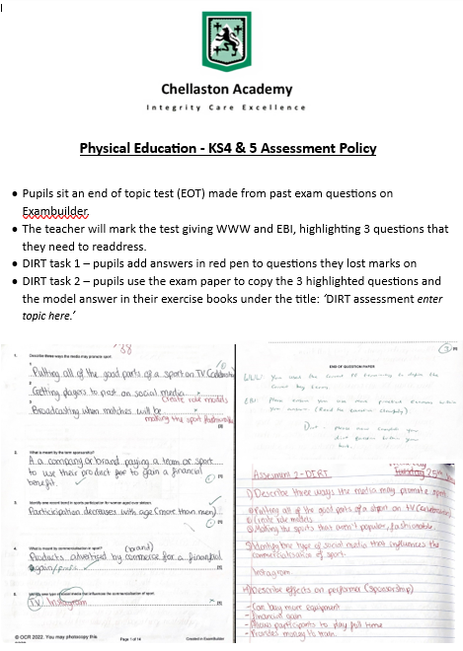

Slide 25

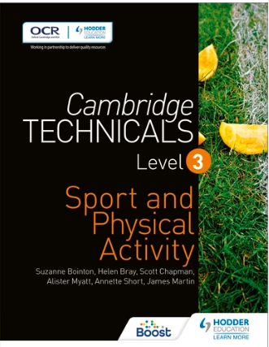
Key Stage 5 Examination PE
Pupils will be guided down a pathway that suits them and maximises their potential in Physical Education
5
https://www.ocr.org.uk/qualifications/as-and-a-level/physical-education-h155-h555-from-2016/
OCR Alevel
Physical Education
OCR website link & Firefly resources
30% Practical assessment (including coursework)
70% Exam over 3 papers (year 13)
https://chellaston.fireflycloud.net/physical-education/ks5-1/a-level-pe
https://www.ocr.org.uk/qualifications/cambridge-technicals/sport-and-physical-activity/#level-3
OCR CTEC
Sport & Physical Activity
OCR website link & Firefly resources
2 Exam units
4 Coursework units
https://chellaston.fireflycloud.net/physical-education/ks5-1/ctec-sport

Slide 26
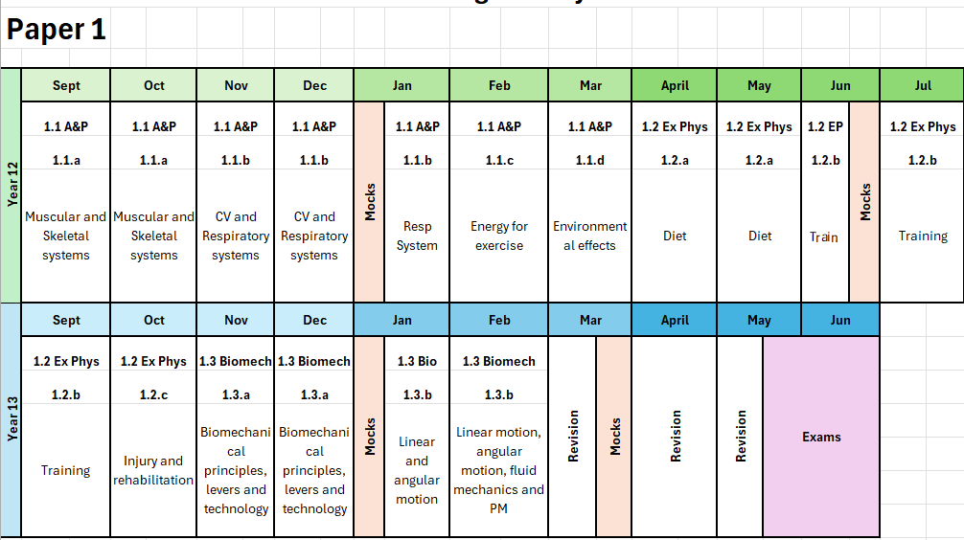
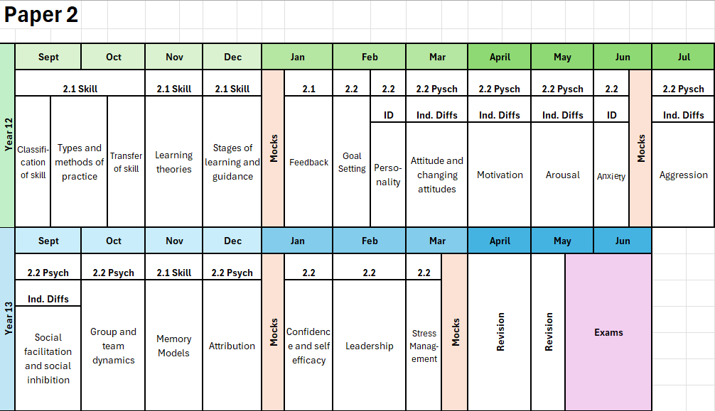
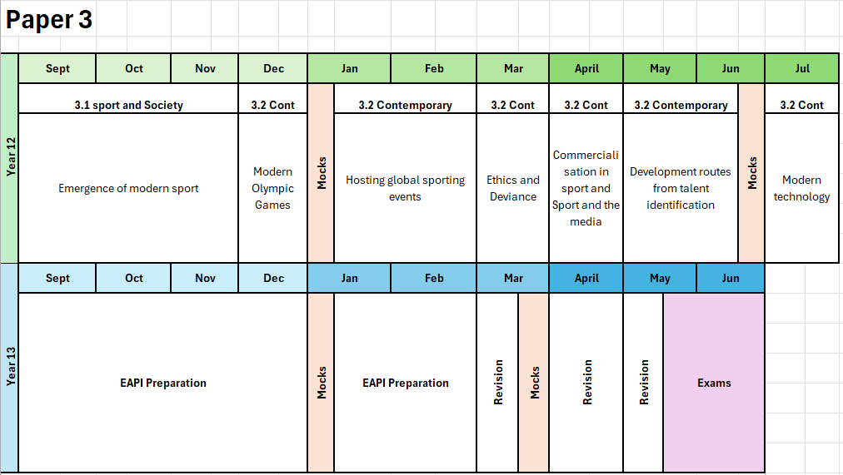
OCR Alevel - Physical Education

Slide 27
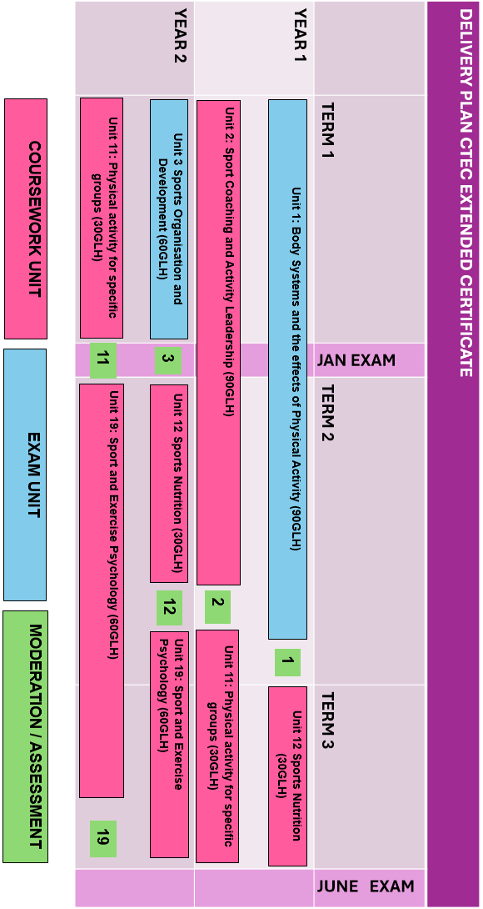

Slide 28

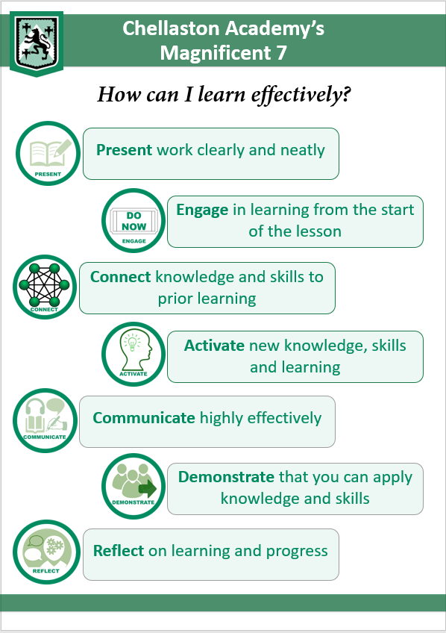












THE CHELLASTON ACADEMY CLASSROOM & PHYSICAL EDUCATION
The Chellaston Way: Delivering Excellence
The Chellaston way is rooted in four evidence driven approaches to create habits of
Excellence for Learning
1
Meet and greet
Language for learning
2
Pupils meet their teacher and line up outside the changing room before their core PE lessons.
Pupils line up outside of the classroom for theory lessons and staff welcome pupils in once their uniform is smart.
Key Stage 3 pupils will have a ‘Literacy focus’ in every lesson to discuss as a ‘Do Now’ and Key Stage 4 pupils have organisational roles to establish as a ‘Do Now’.
Teachers refer to the lesson concept, school values and ‘Head, Heart and Hands’ in lesson to ensure consistency in language across the department.
Impact: Ensures a smooth transition to learning and creates positive relationships. Routines help free up working memory for students to focus on deepening their understanding.
Impact: Our seven evidence-driven pedagogical approaches helps reduce a student’s cognitive load.
.
3
Rigour
Feedback
4
Staff are asked to know all of their students ensuring that lessons cater to their learning. Understanding a student’s context will inform effective responses to behaviour and help build better relationships.
PE theory lessons work in line with the whole school marking and feedback policy. All lessons include verbal feedback and use ‘Cold Calling’.
The core PE lesson structure allows for effective feedback during the ‘teachable moments’ and ‘embedding’ elements
Impact: Knowing your students and their prior learning helps improve cognitive architecture and reduces the potential of losing your students.
Impact: All students have a clear understanding of what and how to progress their learning.

Slide 29






Key Stage 4 and 5 Examination PE
Common pedagogical approaches that we implement in the classroom at Key Stage 4 and Key stage 5.
“Retrieval practice is a learning strategy where we focus on getting information out. Through the act of retrieval, or calling information to mind, our memory for that information is strengthened and forgetting is less likely to occur. Retrieval practice is a powerful tool for improving learning.”
We implement this concept into our theory lessons by using workbooks as a ‘Do Now’.
“Students often gain a false sense of confidence in their abilities to memories new material. Using concrete, relevant, real-life examples can help students understand abstract ideas and extend information retention.”
We implement this concept by applying knowledge to sporting examples and real-life sporting situations.
.
“Interleaving is a process where students mix and combine multiple subjects and topics while they study in order to improve their learning. Interleaving has been shown to be more effective than blocked practice leading to better long-term retention”
We implement this concept by regularly connecting topics or subtopics to deepen understanding.
.
As a department we pride ourselves on our online learning offer. Each examination option has a dedicated Firefly page with teaching resources and assessment materials that pupils can access in their own time. We also subscribe to the Hodder online learning platform called Boost. The majority of our home learning work will be set using Boost. All the information pupils require can be found on our Firefly page.
https://chellaston.fireflycloud.net/physical-education
.

Slide 30







